Slide 1


COMP1030 Lecture #5
Introduction to java

Slide 2
Housekeeping
Our goal - 100% pass rate in this course.
Review the lecture slides ahead of time.
Review the lecture slides after class with a study group.
Repeat the lab at home 1-2 times.
Take notes during class.
Weekly optional tutorials take place every week on Wednesdays, from 3-4pm in room A132.
The four secrets of success

Slide 3
Review
Pseudocode
Flow Charts
If-Else
Nested If- Else
While Statement
Increment/Decrement Operators
Relational Operators
Boolean Operators

Slide 4
for Statement
for (initialization; termination; increment)
{
statement(s)
}

Slide 5
for Statement
class ForDemo { public static void main(String[] args){ for(int i=1; i<11; i++){ System.out.println("Count is: " + i); } } }
class ForDemo
{
public static void main(String[] args)
{
for(int i=1; i<11; i++)
{
System.out.println("Count is: " + i);
}
}
}

Slide 6
for Statement
class ForDemo { public static void main(String[] args){ for(int i=1; i<11; i++){ System.out.println("Count is: " + i); } } }
The output of this program is:
Count is: 1
Count is: 2
Count is: 3
Count is: 4
Count is: 5
Count is: 6
Count is: 7
Count is: 8
Count is: 9
Count is: 10

Slide 7
do-while Statement
class ForDemo { public static void main(String[] args){ for(int i=1; i<11; i++){ System.out.println("Count is: " + i); } } }
Do
{
statement(s)
} while (expression);
The difference between do-while and while
is that the do-while evaluates its expression
at the bottom of the loop instead of the top.
Therefore, the statements within the do
block are always executed at least once.

Slide 8
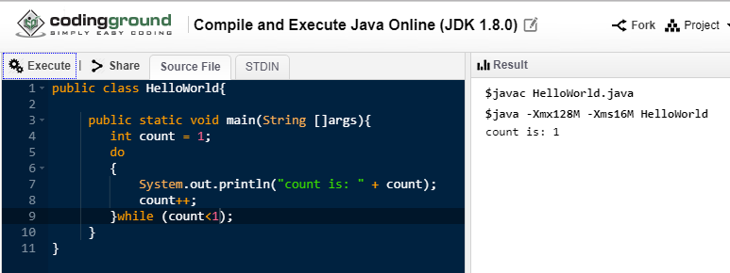
do-while Statement
class ForDemo { public static void main(String[] args){ for(int i=1; i<11; i++){ System.out.println("Count is: " + i); } } }

Slide 9
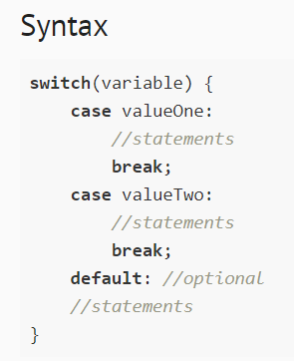
switch Statement
class ForDemo { public static void main(String[] args){ for(int i=1; i<11; i++){ System.out.println("Count is: " + i); } } }

Slide 10
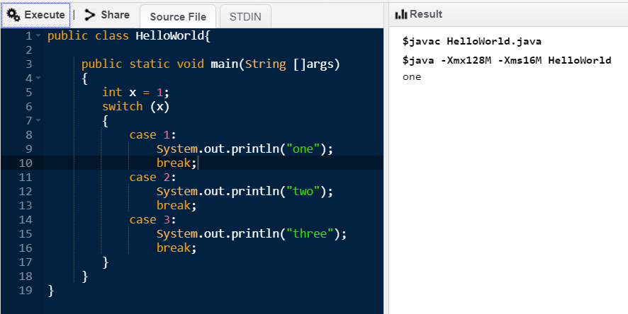
switch Statement
class ForDemo { public static void main(String[] args){ for(int i=1; i<11; i++){ System.out.println("Count is: " + i); } } }

Slide 11

switch Statement
class ForDemo { public static void main(String[] args){ for(int i=1; i<11; i++){ System.out.println("Count is: " + i); } } }

Slide 12

switch Statement
class ForDemo { public static void main(String[] args){ for(int i=1; i<11; i++){ System.out.println("Count is: " + i); } } }

Slide 13
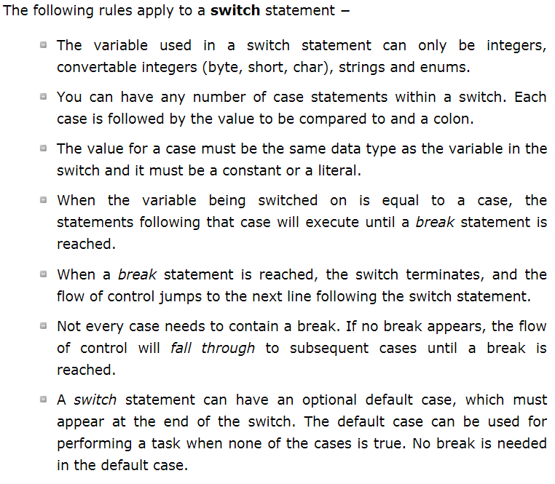
switch Statement
class ForDemo { public static void main(String[] args){ for(int i=1; i<11; i++){ System.out.println("Count is: " + i); } } }

